Slide 1
Explanation

Slide 2
Dictionary Method

Slide 3
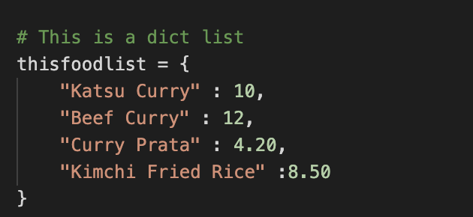
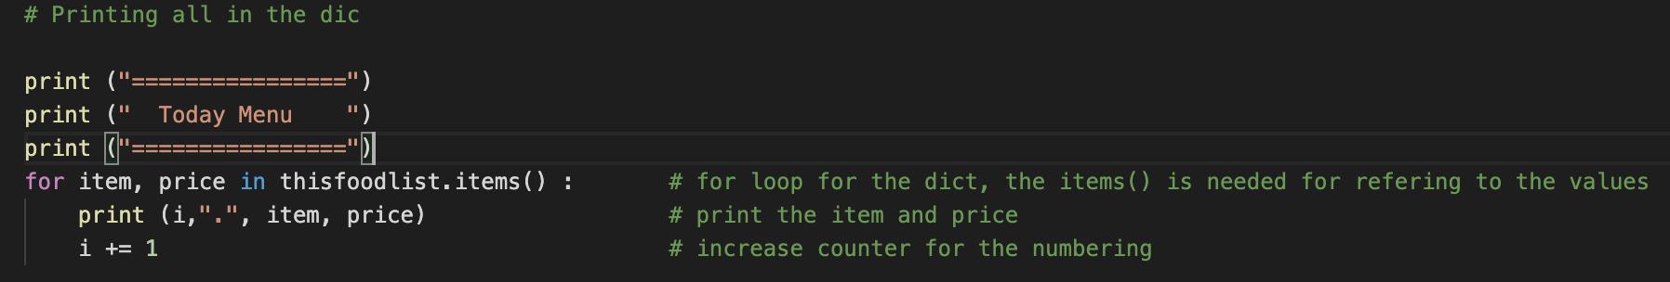
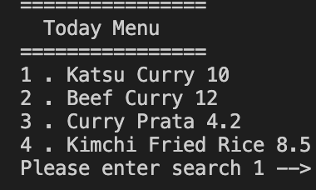
How to access a Dictionary?
The for statement when you put item and price, it is smart enough to know you are referring to 1st element which is food and 2nd element price
You can use anything x or y, item 1 or item 2, python will just treat it as 1st and 2nd element
Output as above

Slide 4
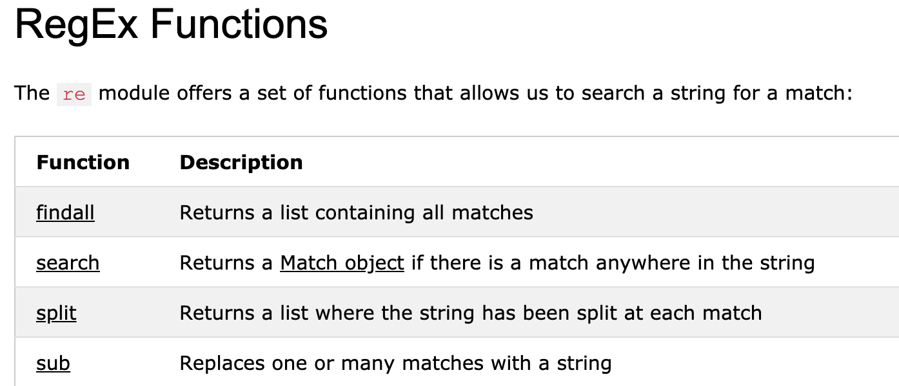
How to search in the dictionary to match a key word?
To do a search, we can use a regular expression module in Python called re, re has many function called built in for you to use like “search”.
To use re, just include “import re” in your python script, and you can start using its function call
In this exercise we are going to use “search”
The syntax to use is
x = re.search(“keyword”, ”strings to be searched from”, additional condition)
If it finds x will return true else false

Slide 5
What we are using
x = re.search (“curry”, item, re.IGNORECASE)
“curry” is your key search
Item is where your item in the list
re.IGNORECASE – is a function in re (if u use it it ignore all upper and lower case, so meaning it is case insensitive)
So if ”curry” is found x will return true

Slide 6
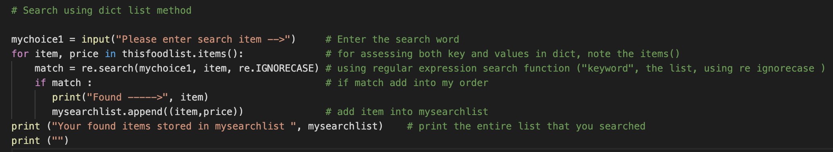
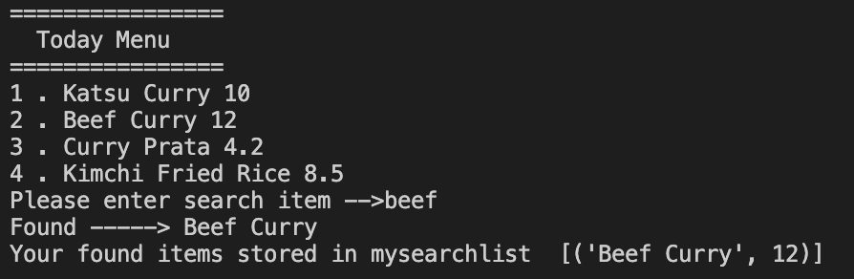
Actual code
Match is a variable, you can use x, y or z

Slide 7
2D List Method

Slide 8
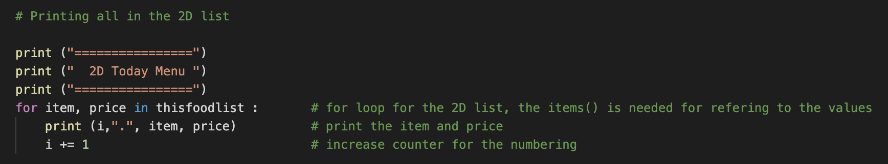
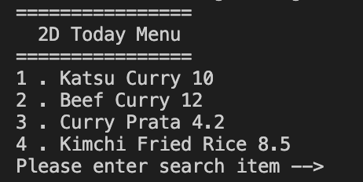
How to access a 2D list?
Declaring a 2D list above
To access a 2D list the syntax is similar except you don’t need the .item() at end of the list
Output as indicated

Slide 9
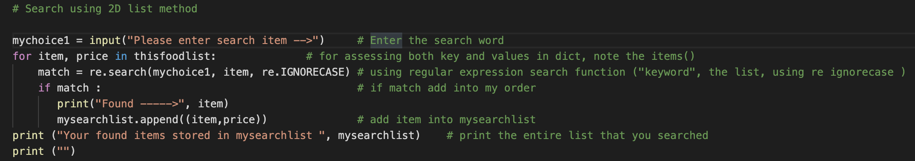
How to access the 2D list?
Similar to the dict access method except you don’t need to use thisfoodlist.item(), you just use thisfoolist
You also can use the re import and use re.search
Everything remains the same

